Slide 1
Introduction to Management

Slide 2
Contents
Definition, characteristics, and principles of management.
Process and functions of management.
Managerial hierarchy.
Types of managers.
Managerial skills and roles.
Emerging challenges for management.

Slide 3
What is Management?
Definition: It is a set of activities directed at an organizational resources (human, financial, physical and information) with the aim of achieving organizational goals effectively and efficiently in a changing environment
Efficiency: getting the most output from the least input (doing things right)
Effectiveness: completing activities so that the organization’s goals are attained (doing right things)

Slide 4
Characteristics of Management
Goal oriented: Every organization has specific goals and general goals. All the activities in an organization are done to achieve these predetermined goals.
Universal activity: The process of management can vary from one organization to another but the basic principles are always the same
Social process: Management utilizes different people as human resources to achieve its goals. Thus management should focus on its goals as well as the goals of employees who work to achieve its goals
Dynamic: The management system used today may not be applicable tomorrow. The concepts and ideologies in management change according to the change in environment and situation.
Group activity: The concept of management is not applicable if there is only one person or proprietor. It always represents a team, group or section of people involved in different managerial functions

Slide 5
Cont…
Distinct process: There are different functions in management as planning and decision making, organizing, leading and controlling. All these functions are interrelated with one another. It describes a clear way to achieve the predetermined goals and does not rely on trial and error approach.
Both science and art: Management is a science because it is based on some basic principles that are universally accepted and it is an art because skill and ability is required to perform these managerial functions.
Multi-disciplinary: Management is multi-disciplinary in nature because the principles and techniques used in management are taken from other disciplines as psychology, sociology, mathematics etc.

Slide 6
Principles of management
Division of work: Specialization of labor is necessary for organizational success.
Authority: The right to give orders must accompany responsibility.
Discipline: Obedience and respect help an organization run smoothly
Unity of Command: Each employees should receive orders from only one superior
Unity of direction: The efforts of everyone in the organization should be coordinated and focused in the same direction
Subordination of individual interests to the general interests: The interest of any one employee or group of employees should not take precedence over the interest of the organization as a whole.
Remuneration of personnel: Employee should be paid fairly in accordance with their contribution.
Centralization: The relationship between centralization and decentralization is a matter of proportion, the optimum balance must be found for each organization.

Slide 7
Cont…
Scalar chain: Subordinates should observe the formal chain of command unless expressly authorized by their respective superiors to communicate with each other.
Order: Both material things and people should be in their proper places
Equity: Fairness that results from a combination of kindliness and justice will lead to devoted and loyal service
Stability of tenure of personnel: Retaining productive employees should always be a high priority of the manager. Stability of tenure helps develop loyalty and attachment of the part of employees.
Initiative: The management should encourage subordinates to thing out and execute the assigned task in a better way. Subordinates should be given freedom to conceive and carry out their plans, even though some mistakes may occur.
ESPIRIT DE CORPS: This principle states that “Union is Strenght”. Espirit de corps says that there must be a team spirit and coordination among the members of an organization.

Slide 8
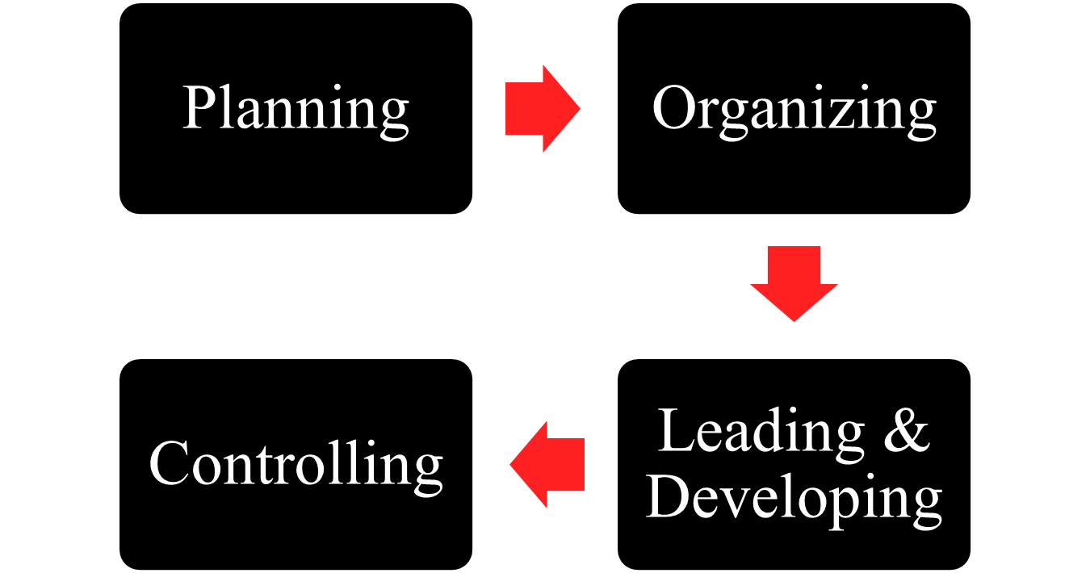
Process and Functions of Management

Slide 9
Planning
Planning is deciding in advance about what to do, how to do it, when to do it, and who is to do it.
Planning is deciding in advance what is to be done and intellectual course of action to be taken to achieve predetermined goals in time.
Outcome of planning is a strategy

Slide 10
Organizing
Organizing is a process of bringing the activities and resources together to achieve the organizational goals.
The process of deciding
  who within an organization will perform what tasks
  where decisions will be made
  who reports to whom
  how different part of the organization will coordinate their activities to pursue a common goal

Slide 11
Leading and Developing Or Staffing
Motivating members of the organization to work in the best interest of the organization is called leading
Leading is done by the managers by the combination of communication, leadership and motivation. It also involves managing the group and teams inside the organization.
Leadership is influencing a group towards the achievement of the goal
Developing meaning training lower level staffs and developing higher level staffs
Staffing refers to the task of hiring, training, mentoring and rewarding employees in an organization, including other managers

Slide 12
Controlling
Whenever that actual performance of an organization cant achieve the expectations, corrective actions are taken by management called control
It is a process of setting a standard, measuring performance comparing actual performance with that of planned performance and take corrective action if there is any deviation
Controlling is to be done to find out the mistakes (deviations) made by the organization and provide remedy as early as possible.

Slide 13

Who Are Managers?
  Someone who coordinates and oversees the work of other people so that organizational goals can be accomplished.

Slide 14
Managerial hierarchy and levels
Refers to the arrangement of managerial position in an organization
Managerial hierarchy is divided into different levels and in each level a manager or a head is appointed
Each level of hierarchy in an organization must have a distinct level of responsibility
Managers are classified as top level, middle level and lower level on the basis of level

Slide 15
Cont’
The common managerial hierarchies practiced in different organizations are as follows:
  Top level management
  Middle level management
  Lower level management

Slide 16
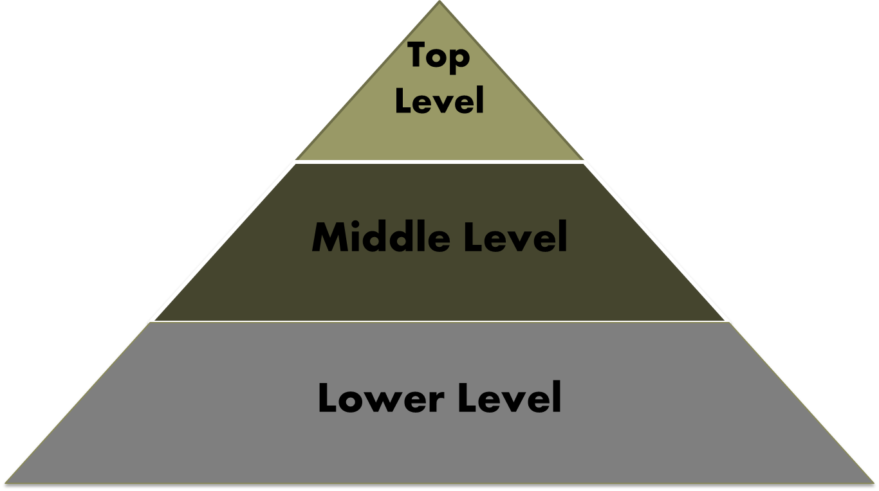
MANAGERIALS LEVELS

Slide 17
Top Level or Executive Management
It is the highest level of management and is responsible for achieving overall objectives of the organization
In corporate enterprise, top level management is constituted with a management committee elected directly from the shareholders as members of BODs
This level also includes a chief executive like a chairman, president, managing director or general manager

Slide 18
Top Level Managers
Formulate corporate level strategies that can affect overall organization
Formulate the culture of the organization
Formulate policies, rules, guidelines in the organization
Bring functional change in the organization

Slide 19
Middle Level or Tactical Management
This level consists of functional heads of different departments and is responsible for preparing & implementing departmental plans
Top level management delegates a major part of its authority and responsibility to this level
In some big organizations, this level of management may have two layers- senior and junior middle level management

Slide 20
Middle Level Managers
Formulate goals and objectives consistent with the goals and objectives of the organization
Formulate strategies for their respective departments
Coordinate different activities in the department
Maintain cordial relation with other departments

Slide 21
Lower or Operating or Front-line or Supervisory Level Management
These are managers who are closest to the core business processes of an organization.
In many cases, this means customer-facing activities such as sales and customer service.
They are in the bottom tier of an organization's management structure below middle management and executive management.
As such, frontline managers often spend much of their time on day-to-day administration and direction of a team.

Slide 22
Lower Level Managers
Handle day to day activities
Managing performance of entry level employees
Make operating plans

Slide 23
On the basis of type (managers classification)
Line mangers: Mangers who are directly in the chain of command are called line mangers. Line mangers involve in the direct activities or the daily operation of the organization. These managers are responsible for the achievement of organizational goals and objectives. These managers have some authority and decision power used for the achievement of organizational strategies. They have some fixed salary and they have to work regularly in the organization. For example marketing manager, operation manager etc.
Staff managers: Staff mangers are the people hired by the organization for the special tasks. They do not participate in the regular activities of the organization but they participate for the completion of specific tasks. They mainly work on task basis i.e. they don’t get regular salary but they get remuneration for the completion of their work. They provide advice and expertise in their specialized area of knowledge. They assist and support the line mangers in undertaking their functions. These managers are outside the formal chain of command. For example, staff managers are required for auditing, legal matters etc.

Slide 24
Managerial Skills
Technical skills
  Knowledge and proficiency in a specific field
  E.g.: An accountant must have expertise in accounting
Human skills
  The ability to understand, alter, lead, communicate, coordinate and control the behavior of other individuals and groups
Conceptual skills
  The ability to think and conceptualize about abstract and complex situations concerning the organization
  Involves seeing the organization as a whole and understand how parts will affect the whole

Slide 25
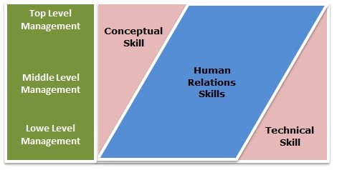
Managerial skills
Technical skill.
Human skill.
Conceptual skill.

Slide 26
Managerial Roles
Interpersonal
Informational
Decisional
Figurehead
Leader
Liaison
Monitor
Disseminator
Spokesperson
Entrepreneur
Disturbance
Handler
Resource
Allocator
Negotiator

Slide 27
Managerial roles
Managerial roles: There can be different positions of the manager in the organization. The expected behavior for a certain position is called a role. There are basically three different types of roles that is played by the managers. These roles are as follows:
Interpersonal roles: Managers regularly communicate with different organizational and non-organizational members. They co-ordinate and help their lower level employees and take directions from the upper- level seniors (if any). They even develop contacts and relationships with different people within and outside the organization. They interact with their peers, seniors, juniors, customers, suppliers etc either formally or informally. There are mainly three different activities performed during interpersonal roles as follows
Figure head role: Managers perform ceremonial work as greeting and receiving visitors, chairing board members and symbolically representing the organization.

Slide 28
Cont…
Leader role: Managers direct, co-ordinate, motivate and maintain control within the organization.
Liaison role: Maintaining relationships internally with different units and externally with the society for building the image, gathering resources etc.
Informational role: Managers handle a huge amount of information regularly. They gain and disclose the information in connection with their work. Information are very important for the organization, so a manager must have a good link with the internal and external environment for the collection, processing and dissemination of such information. There are three different activities that is performed by a manager as informational role as
Monitor: Manager watches the activities that take place inside and outside the organization. He scans the environment and collects useful information.

Slide 29
Cont…
Disseminator: Manager scans the environment as a monitor and transmits the information to the sub-ordinates to make them informed about the situation and prepare them for any uncertainties.
Spokesperson: There can be different issues of the organization. Manager has to deal with these issues and explain the organizational members about such issues.
Decisional role: Managers have to make decisions for different activities for the achievement of organizational goals. They have to allocate the resources, negotiate between the people and handle any disturbances for the smooth performance of the organization. There are four different activities that is performed by the manager for the sake of decisional role as
Entrepreneurship role: Managers have to plan and initiate changes within the organization. They have to search for opportunities and develop important projects inside the organization.

Slide 30
Cont…
Disturbance handler: There can be different disturbances inside the organization as conflicts, fights etc. A manger has to handle such disturbances for the smooth performance of the organization.
Resource allocator: There can be different resources essential for the organization as human, financial, physical and informational resources. A manager has to handle the resources and make full utilization of all the resources.
Negotiator: A manger negotiates between the members of the organization and outsiders to add value to the work.
All mangers working at different levels of the organization perform these roles, but these roles vary according to the authority and responsibility taken by a manager.

Slide 31
Emerging management issues and challenges
One thing that makes the manager’s job exciting is the constant array of new challenges. This sections identifies and briefly describes a number of contemporary challenges that confront all managers today.
Globalization is the process of connecting with the whole world or making the goods and services available to the whole world. Due to the cause of globalization, every products available to any part of the world can be available to our country. This is an opportunity if our organization is capable of competing with the whole world but this is a very big challenge for the managers. Globalization increases the competition and the managers have to work by considering the whole world as one large market.
Environmental issues: These are the biggest issues of the modern world. The environmental issues like deforestation, global warming, depletion of the ozone layer, toxic wastages and pollution of land, air and water has drawn the attention of the society. The managers must be able to gain profit without hampering the environment.

Slide 32
Cont…
Quality and productivity: Quality means “freedom from defects” and productivity means the capacity to produce. Quality and productivity are interrelated with each other. The increase in quality will reduce the number of defects, reduce the wastages and reduce the cost of quality inspectors. Productivity without the quality will never be accepted by the conscious customer. So, a manager must be able to increase the productivity by enhancing the quality.
Ethics and Social responsibility: Ethics are the personal or morale boundaries that binds the individuals. Ethics is an individual’s personal beliefs about what constitutes right or wrong. The most vital ethical concern of modern managers is to know how an organization treats its employees, how employees treat the organization and also how an organization treats other economic agents like customers, competitors, suppliers, unions etc. Social responsibility is the set of obligations that an organization has to fulfill towards the society. A modern manger must be ethical and responsible to the society.

Slide 33
Cont…
Workforce diversity: An organization has a heterogeneous mixture of employees who vary in terms of age, sex, nationality, religion, ethnicity etc. The diversification of the employees can be advantageous to the organization because of the agglomeration (combination) of different ideas, behavior and values. Besides, it is a very big challenge for the managers to manage such people who are different from each other. The diversification can be the basic cause for conflicts inside the organization and a manager must be able to handle such conflicts.
Innovation and change: Innovation is a process of developing entirely new ideas or concepts about anything and change is the process of alteration from one phase to another phase. Change is inevitable and it can occur in the behavior of employees, competitors, stakeholders, suppliers etc. it is the responsibility of the managers to handle the change and innovate new products to sustain in the changing environment.

Slide 34
Cont…
Empowerment of employees: In this modern era, the employees are more powerful due to the decentralization of authority. The lower level staffs can make the decisions and work for the achievement of organizational goals. This is a very difficult task. Besides, the lower level employees have become more powerful due to the cause of unionization and labor strikes. This is a serious threat for the modern organizations.
Multi- cultural effects: There are different people working inside the organization who vary in terms of traditions, values, social attitudes, religious believes, and living approaches. Besides, the organization working in global market should also consider about the living pattern and religious background of the customers. This is a very big challenge for the modern organizations.

Slide 35


